Slide 1

Django Intro to urls, Regex, views and templates
Web 3

Slide 2
Overview
Django uses an MVC, or Model View Controller, architecture
However, Django calls these pieces by different names
MVT
The four pieces to understand for Django are:
URL patterns
Views
Models
Templates

Slide 3
Django MVT Design Pattern
URL Patterns
Views
Templates
mysite/urls.py
blog/views.py
blog/templates/
blog/urls.py
Models
blog/models.py

Slide 4
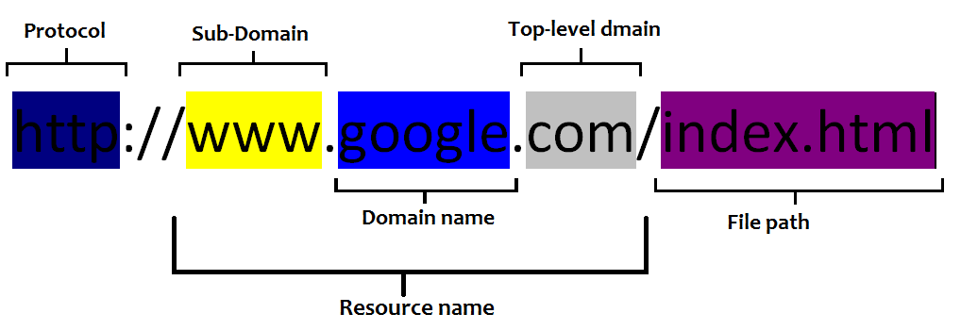
A word about URLs matching

Slide 5
Examples
Models
blog/models.py
URL Patterns
Views
Templates
mysite/urls.py
blog/views.py
blog/templates/
blog/urls.py
http://yoursite.com/
/
index
Index.html
http://yoursite.com/post/3
/post/3
post_detail
Item_detail.html

